Slide 1

Automatic Setup Generation Software for UT Inspection of Engine Discs
General Requirements
Michael Bron

Slide 2
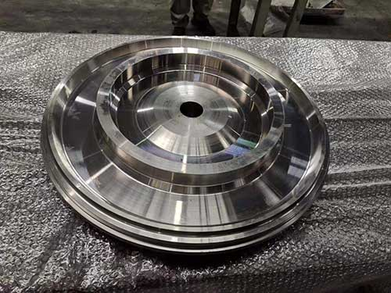
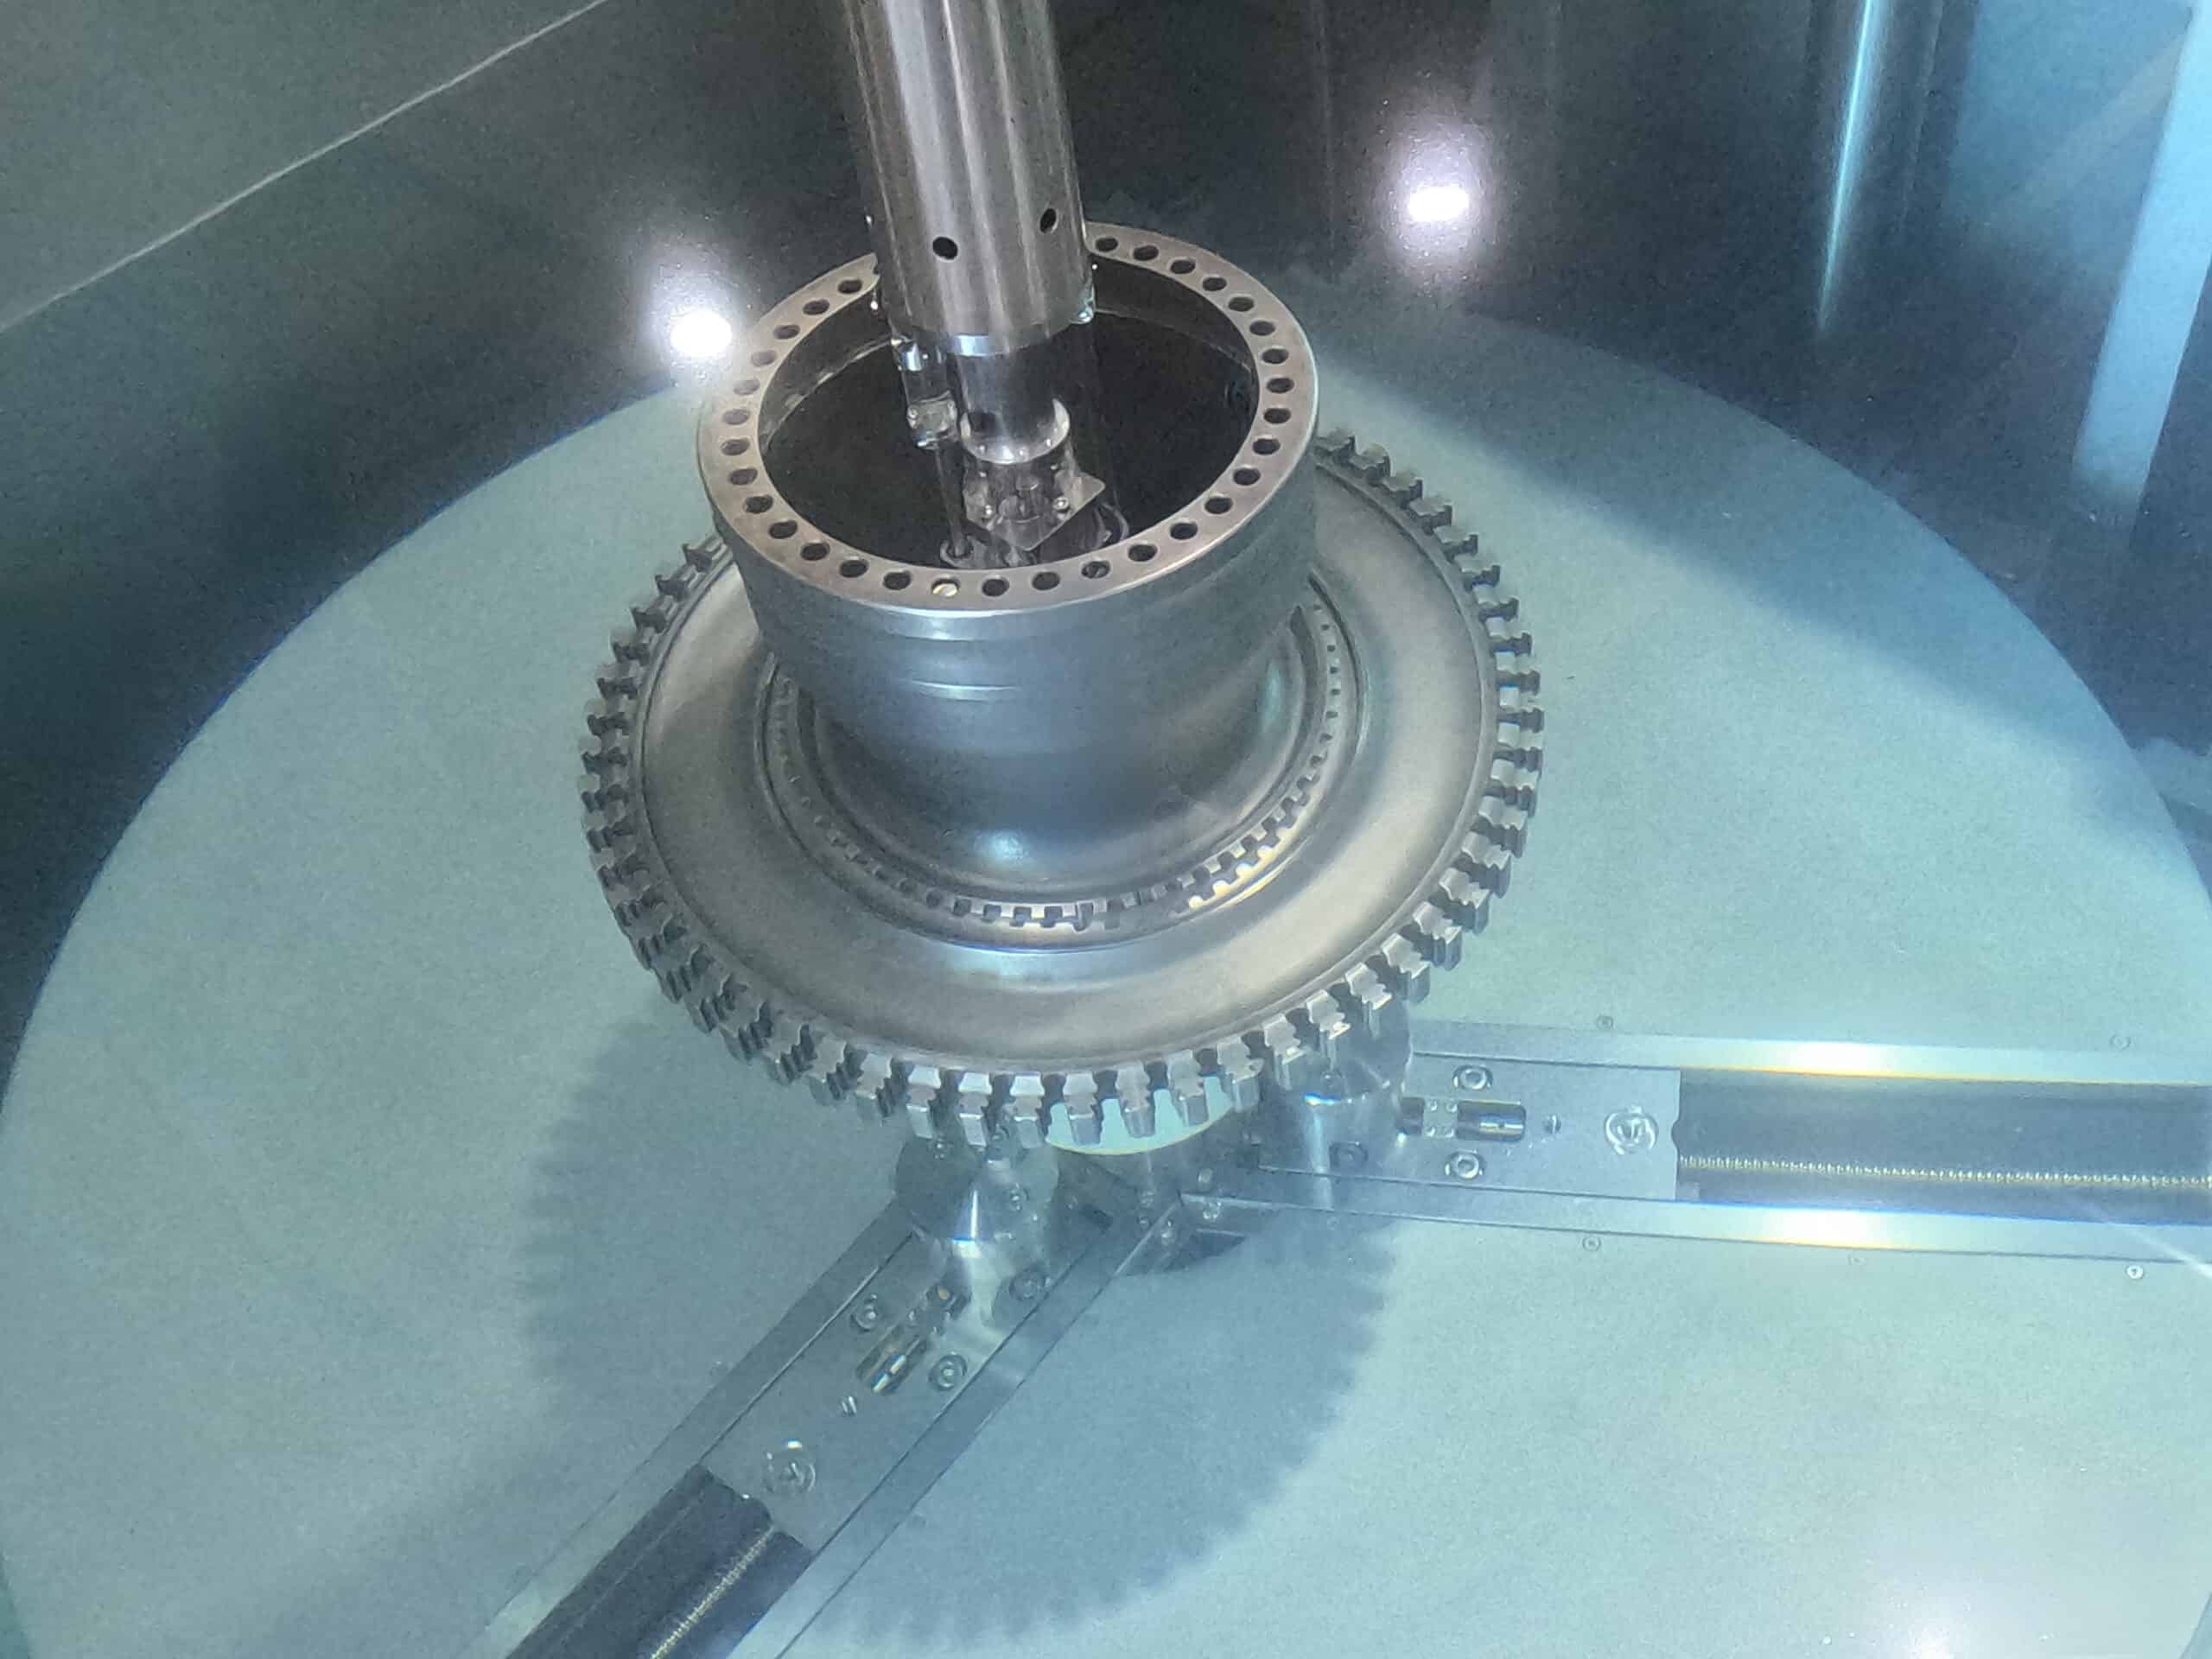
Executive Summary
Business goal: Reduce setup engineering time, improve repeatability, strengthen OEM compliance
Key outputs: Techsheet + Inspection Plan Base + UT Settings + Patch Plan + Block/Tooling selection
Scope: MRO / Production + OEM spec families (GE/RR/PW)
Deliverable: Software for generation of the setups, suitable for import into SM’s CSI software
Development phases:
Phase 1 MROs
Phase 2 Production
Phase 3 Self learning capbilities

Slide 3
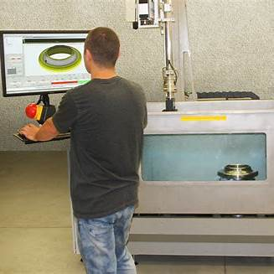
Problem Statement and Current Pain Points
Verity of OEM requirements
Manual setup generation is slow and expert-dependent
Limited availability of expert-level personnel – especially in MRO’s
Inconsistent patching, UT parameter selection, and block/tooling choices
Difficulty maintaining compliance across OEM spec changes and part revisions
Audit burden: proving “why this plan and these settings” is time-consuming

Slide 4

Objectives and Success Metrics
Objectives:
Software capable to generate all relevant information for establishing of UT inspection of the parts ( tech sheets, probes, blocks, etc.)
Software capable part inspection setups suitable for import into ScanMaster’s CSI software
Success Metrics:
Engineering cycle time reduction (e.g., days → hours including validations)
First-pass acceptance rate at FAT/SAT / internal validation
Reduction of nonconformities related to documentation/configuration
Full traceability: Part Rev → Spec Rev → Plan/Settings → Evidence/Approval

Slide 5
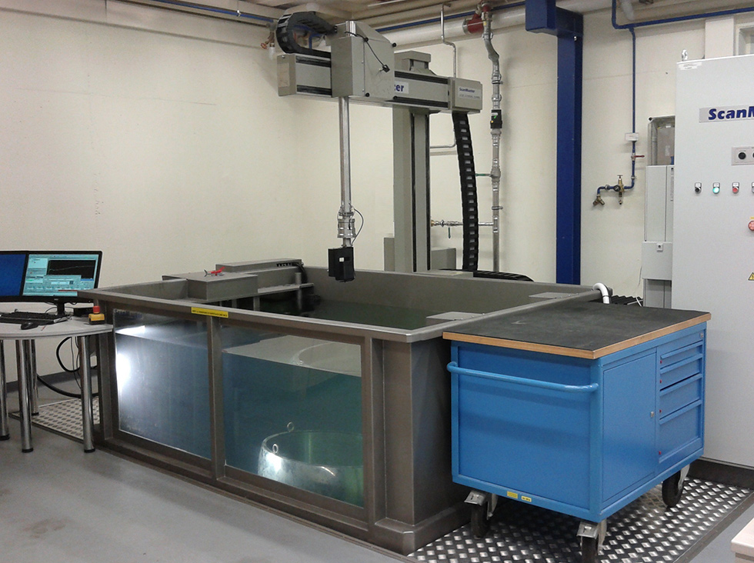
Phase Strategy: MRO First, Production Second
Phase 1 (MRO) characteristics
Higher variability: part condition, repairs, mixed pedigree
Lower volume, higher engineering involvement
Limited up to none availability of qualified UT personnel
Focus: Simplicity, robust documentation + operator guidance + fast iteration
Phase 2 (Production) characteristics
Higher volume, standardization, automation and throughput
Strong integration to MES/PLM and strict version control
Focus: stability, performance, locked-down configuration

Slide 6
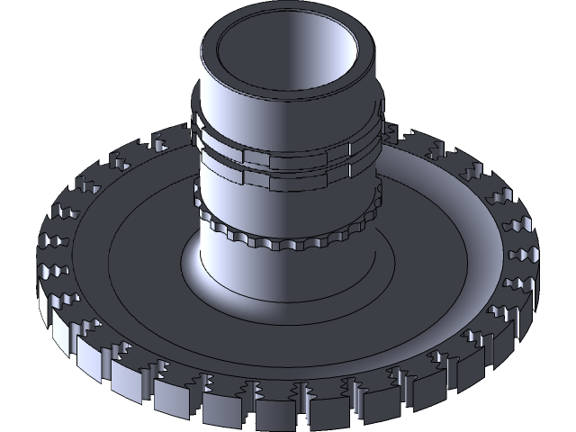
What the Software Must Consume
Input Data:
Part(s) definition: CAD/mesh or parametric model, datums, surfaces, critical zones
OEM specifications: inspection coverage rules, transducer types, calibration rules
Configurable options:
Internal standards: naming conventions, templates, station capabilities
Equipment constraints: scanner kinematics, probe/tool limits, tank/fixture limits
Library data: blocks, wedges, probes, holders, cable sets, software features

Slide 7
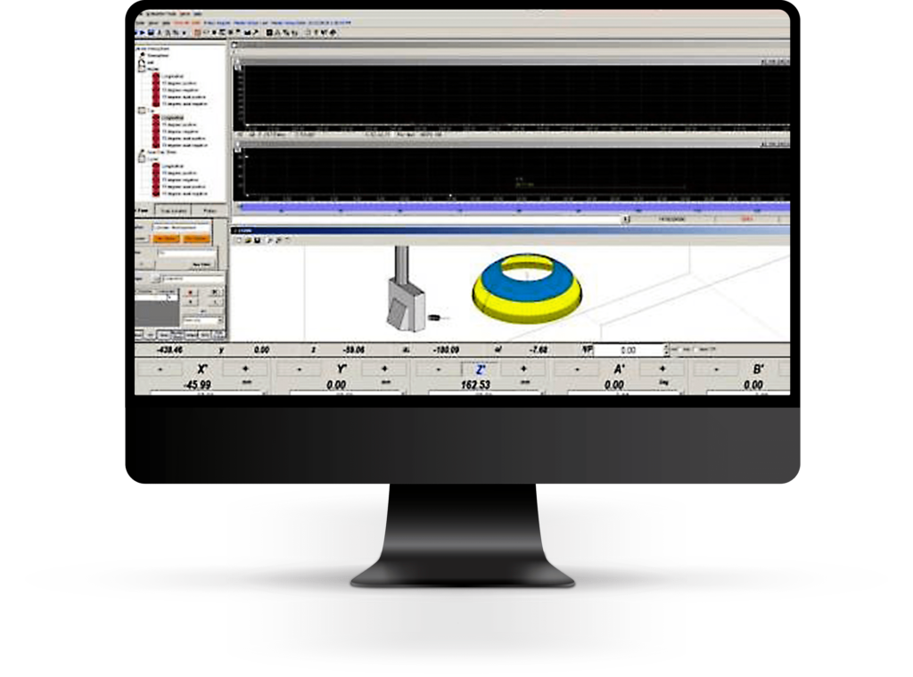
Functional Requirements: Planning Engine
Automatic identification of scan surfaces and “inspectable” regions
Patch generation logic:
Patch sizing constraints, overlap, edge handling, exclusions
Rules for transitions between surfaces and blend radii
Scan path generation per patch:
Raster/spiral strategy selection by surface type
Index/step size rules and speed constraints
Coverage validation:
Coverage map, unscanned gaps detection, minimum dwell, incidence constraints

Slide 8
Functional Requirements: UT Configuration Rules
OEM/customer rule sets per program (GE vs RR vs PW)
Probes Parameter derivation:
frequency/aperture, focus depth ranges, angle sets
Calibration and verification:
Required reference blocks, temperature checks, DAC/TCG instructions
Periodic checks and acceptance thresholds (as rules, not free text)

Slide 9
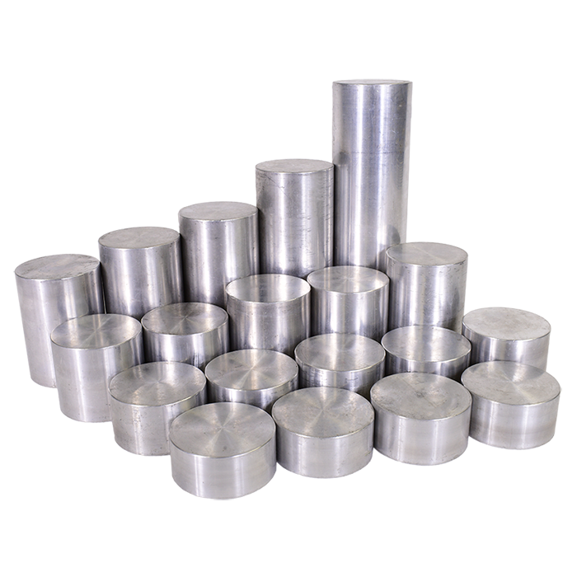
Functional Requirements: Block / Tooling Selection
Block library management:
block type, geometry, serial, status, calibration validity dates
Rule-based selection:
which blocks required for which part/surface/program
substitution rules if preferred block unavailable
Output in techsheet:
exact block IDs (or block family + allowed options), setup sequence

Slide 10
Functional Requirements: Tech sheet Generation
Template-driven tech sheet generation (per OEM + per site + per machine)
Embedded diagrams:
Patch map snapshots, scan direction arrows, datum references
Operator instructions:
Step-by-step setup + calibration + run + checklists
Export formats:
PDF for controlled release; optional DOCX for engineering drafts
Language support if required (English baseline; optional site language)

Slide 11
Non-Functional Requirements
Performance:
Setup generation time targets by part complexity – less than one hour of interactive process
Reliability:
Deterministic outputs – POD
Cybersecurity:
User authentication, role-based access, secure audit logs
Compliance:
Controlled document generation, retention, traceability (audit readiness)
Usability:
Guided workflow, minimal expert-only steps, operator-friendly outputs

Slide 12
Desired time frame
Phase 1:
Pilot for 2-4 parts PW Mid of 2026
Beta - End of 2026
Final version -Mid of 2027
Phase 2:
Mid-End of 2028

Slide 13

Thank you.
ScanMaster Systems (IRT) Ltd.
5b Atir Yeda St. Kfar Saba, 4464305, Israel
Tel: + 972 9 7791990
Fax: + 972 9 7791989
E-mail: info@scanmaster-irt.com
Web site: www.scanmaster-irt.com
ScanMaster (IRT) Inc.
1200 Woodruff Road, Greenville, SC 29607, USA
Tel: + 1 864 288 9813
Fax: + 1 864 288 9799
E-mail: info@scanmaster-irt.com
Web site: www.scanmaster-irt.com

